Slide 1
Infomineo presentation

Slide 2



As a senior professional you face many challenges – here is what we hear from you
I am anxious when I take decisions because I don’t have strong data
When I work during the night it is either to do my slides or do some research
I have multiple jobs in one – Finding information, designing presentations, translating... Impossible to do in a normal workday!
When I want to get rid of some tasks, I ask an intern or a junior – Not great but no choice
Outsourcing? The admin processes are so heavy that I prefer to do the work myself
We use providers but they have zero critical thinking – I only use them for basic stuff
If you could have said any of these then move to next page!
Analytics? Too many Data with bad quality – Very difficult to use
I would love to have an automatized Dashboard but I don’t know where to start ?
My clients demand that I translate all my work to Arabic – But I can only find unstructured free lancers
Research? I type my question on Google between 2 calls ;-)
My worst nightmare? Powerpoint
I would like to use more data to get insights but I don’t have the right capabilities in my team

Slide 3











To increase your performance, you need to focus on your core capabilities and outsource others
Entities need to operate a number of different activities...
Investing in non-core capabilities is generally a bad choice because it
Successful outsourcing comes from
Finance
HR
Supply Chain
Uses capital which would be better invested in the core capabilities
Divests management attention
Often doesn’t yield the expected results due to:
lack of expertise
lack of scale
Partner expertise in the field gained through scale and exposure to multiple clients
Marketing
Operations
Transparency over the partner operations
Purchasing
Research
R&D, Etc.
Entities therefore need to
Invest heavily in and focus on the activities which are a source of competitive advantage
Outsource the other activities
Partner’s scalability and cost competitiveness, driven in particular by the locations where the partner operates
... But the competitive advantage of each entity relies on only some of these activities, their core capabilities
Copyright © 2020. All rights reserved.

Slide 4







Infomineo invented Brainshoring, a new generation of service outsourcing, to solve your problems
In service outsourcing there are four possible levels of value add
Call centers handle basic, heavily processed conversations (sales, customer support)
Business Process Outsourcing (BPO) consists in transferring simple and repetitive processes, mostly handled by clerks (high school to bachelor degree)
Knowledge Process Outsourcing (KPO) transfers more complex processes, which don’t require extensive analytical thinking or client communication
Brainshoring transfers tasks which require substantial client collaboration AND problem solving skills
Key success factors in Brainshoring
What Infomineo does
Selecting activities which require problem solving and close collaboration and which can be executed remotely
We offer a range of Brainshoring services – Data Research, Graphic design, Language services and Data Analytics
Hiring and training staff who offer strong critical thinking and communication skills
We operate from major cities in the emerging world (Cairo, Casablanca and Mexico City) to
Tap in underleveraged talent pools and deliver high-quality work at decent prices
Offer nearshore/same time zone options to our clients
Using delivery locations which allow live discussions with clients
Building integrated relationships with clients as “ecosystem partners”
We make it easy to work with us by dealing with our clients on a retainer basis, i.e. with dedicated teams

Slide 5
































Infomineo has grown into the leader of Brainshoring
235 employees, 55% of women Mix of business and technical (engineering, design) backgrounds
300,000+ requests successfully executed
97% of requests rated as meeting or above expectations
25 nationalities, 18 languages spoken natively
5 offices Casablanca, Cairo, Mexico, Dubai and Barcelona
Geographic distribution of our work: 40% Europe, 40% Middle East and Africa, 20% ROW
90% of our business on a retainer basis
Clients
All the leading consultancies and 50+ of the Fortune 500 companies

Slide 6







Infomineo offers a suite of Brainshoring services
Data research
Getting the right insights to make better decisions
Desk research
Getting insights through free and paid data sources
Graphic design
Primary research
Building new data through interviews (cold calling or Expert Interviews), or field work
“Brainshoring”
Presenting messages in a meaningful and beautiful way
The business of offshoring tasks that require extensive communication and critical thinking/problem solving skills
Language services
Tech enabled research
Using technology to generate data and insights
Translating business content between languages without betraying the original message, and advising on language related issues
Data Analytics
Analyzing data to extract relevant insights and identify trends to answer business questions

Slide 7
How Infomineo’s approach is different
Data analytics
Data transformation
Data science
Dashboarding
What you normally get
How Infomineo is different
Providers usually focus on execution, without much attention to:
Context
Objectives
Packaging (delivery format)
Infomineo adopts a problem solving approach – Starting with a business challenge and ending will a fully handed over final deliverable
Intake
Execution
Delivery
Understanding the context and objectives to be able to propose the best approach
Leveraging our full range of capabilities to maximize output quality and work efficiency
The work is not considered as closed until the output has been properly summarized, packaged and handed over
Providers tend to specialize in one service or one approach, which leads to:
Forcing the client to use their approach even if it is not the most relevant
Juggle between multiple providers, therefore wasting a lot of time
Infomineo is a «one stop shop» by integrating a suite of services valuable to top executives, helping them save time and leverage the proper expertise
Intake
Execution
Delivery
Data research
Desk research
Primary research
Tech enabled research
Graphic design
Creative
Enhanced
Basic
Language services
English
Arabic
French
Data analytics
Data Visualization
Data Transformation
Data Science

Slide 8
Data Research

Slide 9

Infomineo has a unique approach to Research
Research
Traditional model
Infomineo model
Researchers see themselves as “data gatherers”, they are experts are finding data
Most research providers focus on one approach – Expert interviews, market research, macro economic research...
Most providers work on a project basis – With a heavy RfP to contracting process and with the need to have a 100% defined upfront requirement
The providers retain rights on the Intellectual property they generate
We are problem solvers, we need to understand your question or challenge and will find the data which answers your question – What matters is the insight, not the data
We are a one stop shop, we will advise you reg. the best research methodology in our complete portfolio of approaches – In most cases we will triangulate different approaches
We work on a retainer basis, we are an extension of your team, and make it easy to work with us, which 1/minimizes the time you spend on paperwork and 2/allows you to work with us on an iterative basis
The output is exclusive to our clients and the IP belongs to them – Therefore is a source of competitive advantage

Slide 10

Infomineo offers a complete range of Research services
Research
Four Levels of Research
Combination of Approaches
Three Types of Support
Country selection, demographics, economy, doing business etc.
Open sources and paid sources such as Orbis, Capital IQ and Factiva
Answering research requests to support project execution, proposal development or internal discussions
Country
Via online surveys, cold calling, and Expert interviews
Ad-hoc
Market sizing, competitive landscaping, road to market/value chain mapping etc.
Market
Desk research
Primary research
Preparing newsletters, regular benchmarking, tracking competitive moves etc.
Company financials, company profiling, supplier/client identification etc.
Tracking
Company
Tech enabled research
Performing online surveys, getting insights from social listening, organising expert interviews
Database creation, thought leadership
Consumer/ Expert
Social listening, web scraping
Content development

Slide 11








Our approach to helping you
Research
Intake
Execution
Delivery
Understanding client needs and objective
Get a deep understanding of the client objectives: Type of decision or analysis considered, planned use of the insights
Define which data would “make the point”
Structuring approach
Define the best research strategy to answer the client’s business objective
Assess and validate the time needed
Define the type of output needed
Executing the research
Leveraging a full range of research capabilities
Desk research
Web search
Research on paid databases (Orbis, Factiva, Capital IQ, Refinitiv etc.)
Primary research
Cold calling
Expert interviews
Online surveys
Deriving insights
Performing in-depth quality assurance, in particular triangulating results
Analyzing the data to derive insights in line with the initial client ask
Packaging
Choosing the best way to illustrate and structure our results
Ensuring consistency in the formatting and “look and feel”
Handover
Speaking with the client to explain the approach, results and potential limitations
Sharing all the backup documentation
Getting client feedback
Suggesting next steps as relevant
Desk research
Primary research
Tech enabled research
Tech enabled research
Social listening
Web scraping
Complementing with the other Infomineo services

Slide 12






Some databases and tools we subscribe to
Database
Functionalities
Use cases examples
Qualitative and quantitative information on public and private companies
Generating a list of companies based on criteria (eg: location, industry, size)
Generating a list of transactions (M&A or other forms) based on the same criteria
Creating advanced excel models using proprietary formulas
Top XX companies in YY industry
List of IPOs in a specific timeframe and industry
High level company profile of 10 players
CEOs change in S&P 500 companies in the last xx years
TSR and stock data for a list of companies
Qualitative and quantitative information on public and private companies
Generating a list of companies based on criteria (eg: location, industry, size)
Top XX companies in YY industry
Financial ratios for a list of companies
Batch search for 100+ companies
Press search based on advanced and proprietary Boolean operators
News alerts on companies/ industries
Access to premium and sectorial press sources (eg: FT)
Weekly newsletter on XX industry
Key developments of a company in the past xx years
Market trends and analysis
Social listening
Evaluating brands
Market data and prices
Company data (including investment research)
M&A transactions
Projects data in MEA region
List of projects in specific industries with their projects value
Analyst reports on public companies
Market and consumer data on 80 000 topics
Consumer trends
Market drivers

Slide 13





Examples of Requests - Research
Research
Research perimeter
Examples of requests we address
Examples of deliverables
How are the demographics of a given country or region evolving?
How is the business environment like?
What are the trade and investment flows between countries?
Which countries can I consider open for my business?
Demographic analysis
Trade analysis
Country selection
Ease of doing business analysis
Country
What is the size of my market in a given country?
How is the value chain of my industry organized?
What are the retail prices of my products vs my competitors?
Market sizing
Competitive landscaping
Route to market analysis
Market
How is the salesforce of my competitors organized?
Can I get a database on the distributors of my products in 5 countries?
Can you identify and approach potential acquisition targets?
Competitive benchmarking
Distributor or supplier selection
M&A target screening
Company
What do consumers think about my product offering?
What is the opinion of experts on future industry trends
Can I get a clear understanding of buyers and their purchasing criteria?
What are the market trends ?
Expert interviews
Social listening analysis
Online survey results
Individuals

Slide 14







A few illustrations of the time required to deliver
Research
A simple request
Five company profiles
A press search with a summary
3 hours
A weekly news digest on an industry
4 hours per edition
A company screening, including longlisting, shortlisting and profiling
40 hours
A market sizing
80 hours
A market landscaping
Players, value chain, regulation
60 hours
A database with market statistics
4 hours per country
An in-depth interview with an expert (incl. meeting notes)
6 hours
These figures are estimates, timings can vary depending on complexity of work and scope. These are illustrative only.

Slide 15






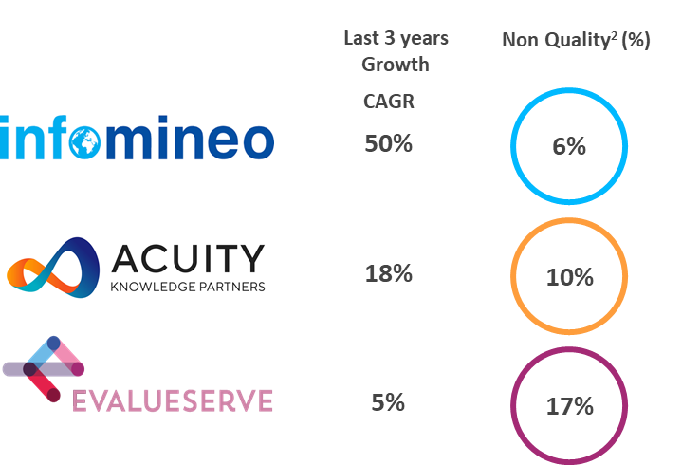

CASE STUDY
Client Challenge
Our Solution
Outcome
The firm recognized that the quality of the research service provided matched that of their internal capacity, resulting in:
Client:
The client sought to expand its information coverage within Europe, Africa and the Middle East.
The firm was looking for:
The consulting firm decided to leverage Infomineo’s research services as a solution to cover:
A global strategy consulting firm
geographies where they did not have existing internal support staff (The MEA region)
Geographies where they needed to scale (Europe)
52
Scaled to 52 dedicated staff
Effective and quick solution
Smooth integration with its existing research processes
“A big thank you to all those who worked on this request – your speed and flexibility is really an asset for us.”
─ Research Analyst (Client)
Infomineo became the preferred research supplier
Lower cost than hiring and retaining research analysts internally
“Thank you very much for the output, this is exactly what we needed in terms of content.”
─ Research Analyst (Client)
Ad-hoc requests to get needed information
Competitor 1
Competitor 2

Slide 16





Why work with us
Research
Combination of strategy consulting and Data Research methodologies
Access to leading vendor databases (Capital IQ, Thomson Reuters Refinitiv, Orbis, Factiva…)
Opportunity to work with a unique professional network
Optimum confidentiality and integrity - ISO certified
World class Data Research capabilities
As a third-party provider, easier access to industry/company specific information (especially through interviews) and no bias
Full compliance with confidentiality and ethics best practices
Delivering objective and neutral information
Leverage our scale, experience and expertise at your service – among the largest Data Research team in EMEA and the Americas with 200 permanent staff
Different engagement models balancing price and flexibility
Offering flexibility and scalability
Multiple advantages of our nearshore locations (Casablanca , Mexico & Cairo): Reasonable cost base, although offering high quality of service (staff with critical sense, same time zone etc.)
Benefits of pooling resources between several clients: vendor databases costs, etc.
Providing value added services at a competitive price

Slide 17
Graphic design

Slide 18

Infomineo has a unique approach to Graphic design
Graphic design
Traditional Graphic design model
Infomineo model
Designers are “artists”, they are experts regarding the form rather than the substance, and can have difficulties to fully understand the content they should represent
Outsourced Graphic Design focuses on low value add slide production, with limited advisory component in the work
Three types of providers cover the market
Large outsourcing companies focusing on volume work
Independent freelancers covering a large scope with limited scalability and not enough guarantees (confidentiality, quality etc.)
Creative agencies focus on marketing related content
Our Designers have both strong business acumen and creative thinking
They understand and like business
They are trained and immersed in a business-friendly environment
We focus our design work on high-end business-related design – We understand the content you want to represent
Infomineo hires full time designers working from the office
We are an outsourcing company managed by former consultants – We understand your agenda and put in place the processes which fit your needs the best
We work exclusively for consultancies, government entities and large corporations

Slide 19

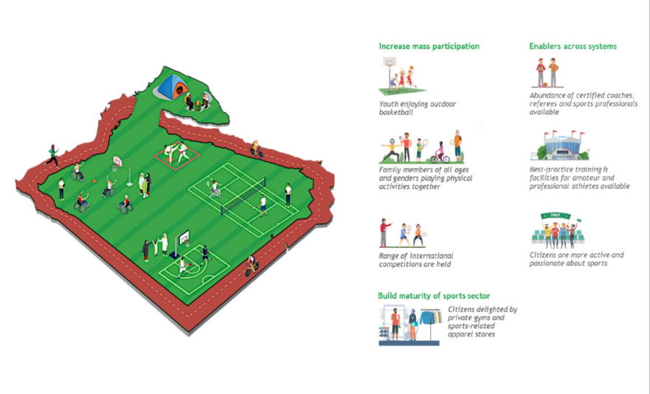
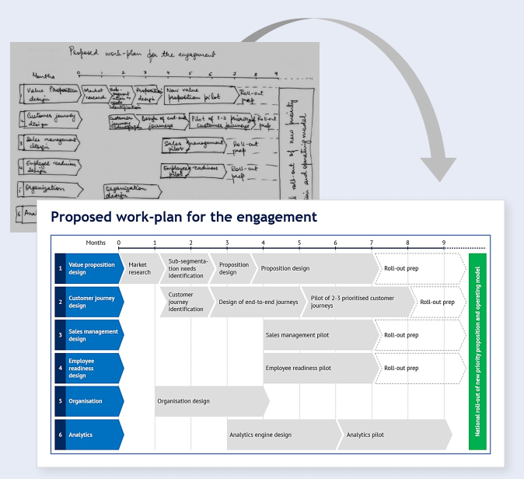
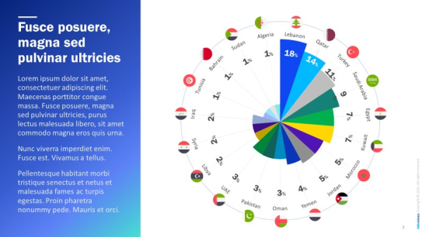
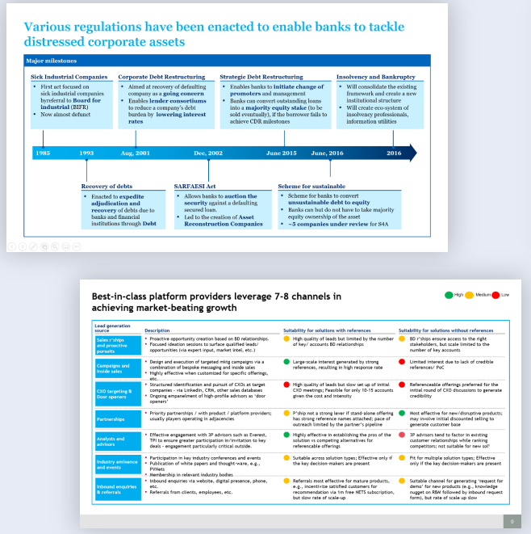

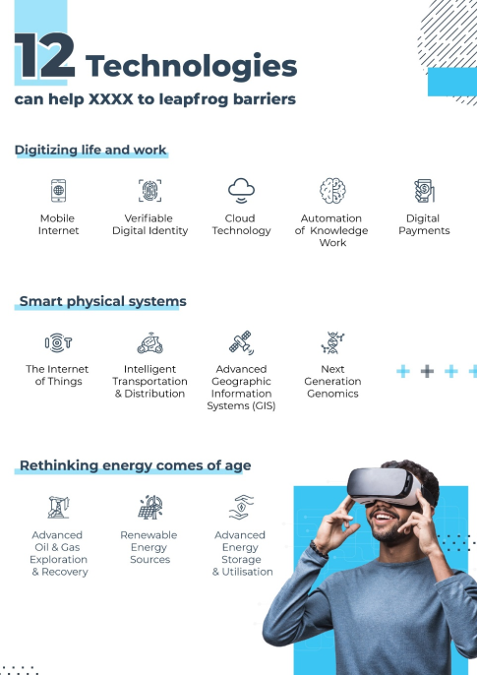

Infomineo proposes three levels of value add
Graphic design
Standard
Advanced
Creative
Our designers take your sketch or draft and put it in whatever medium you prefer in a consistent and rigorous way
Our designers take your draft and find ways to improve its design by restructuring it, adding visuals or others.
Our designers propose creative ways to illustrate concepts and ideas
We cover a wide range of design formats – PPT presentations, pdf brochures, infographics, videos etc

Slide 20
Our approach to helping you
Graphic design
Intake
Execution
Delivery
Understanding client needs and objective
Structuring approach
Executing Design
Handover
Get a deep understanding of the client objectives, context and expectations: Print or presentation? Sober or creative? High or low stake?
Understand the constraints – Deadline, time budget etc.
Define the best design strategy and tools
Assess and validate the time needed
Define the criteria of success
Leveraging multiple tools
Powerpoint
Infographics
Pdf etc.
Different design “depth”
Basic design
Enhanced design
Creative design
Sharing different design options as required
Regular iterations with client
In-depth Quality Assurance
Speaking with the client to explain the design choices
Explaining any technical elements (for ex. how to use a template)
Getting client feedback
Agreeing on potential next steps

Slide 21
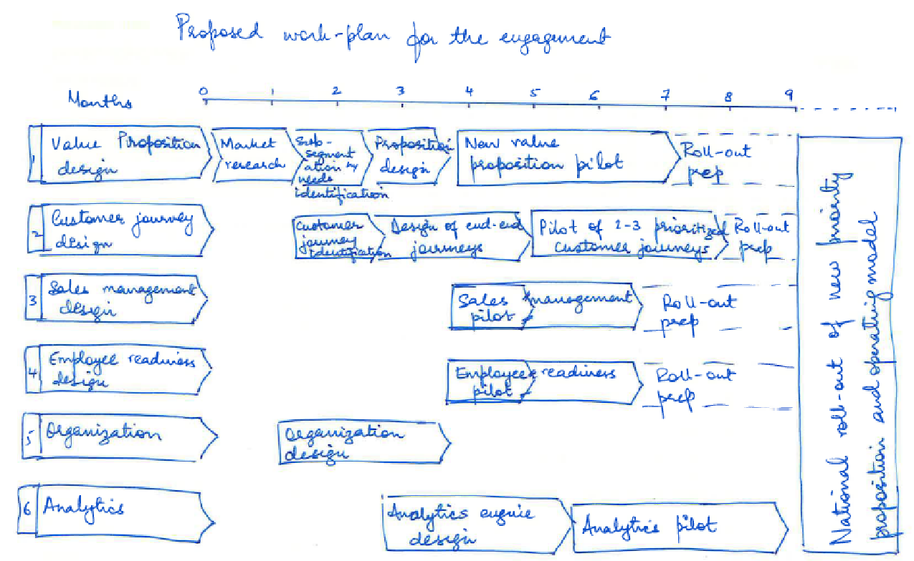
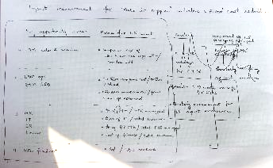
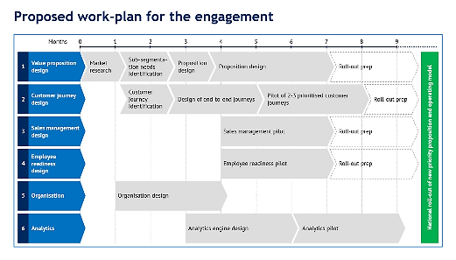
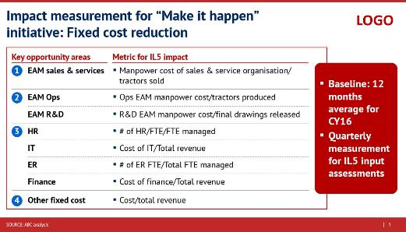
Our work - Standard Design
Graphic design
Creating new slides from scratch

Slide 22

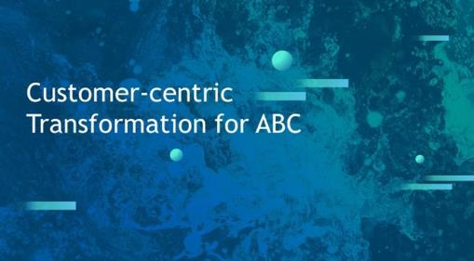

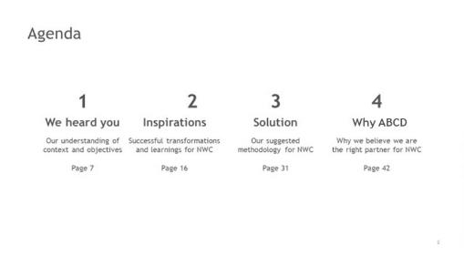
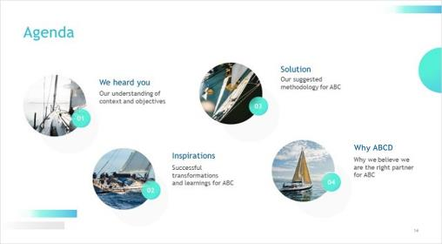

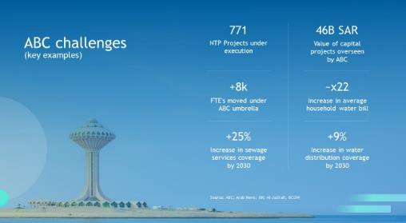
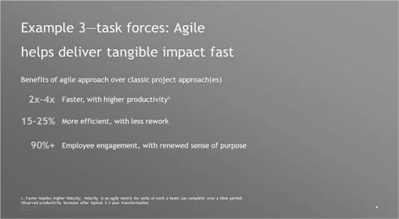
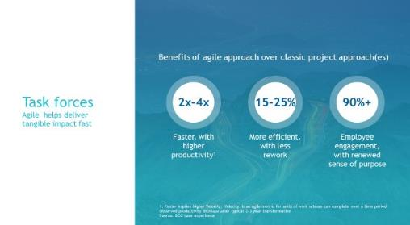
Our work - Creative Design
Graphic design
Before
After

Slide 23
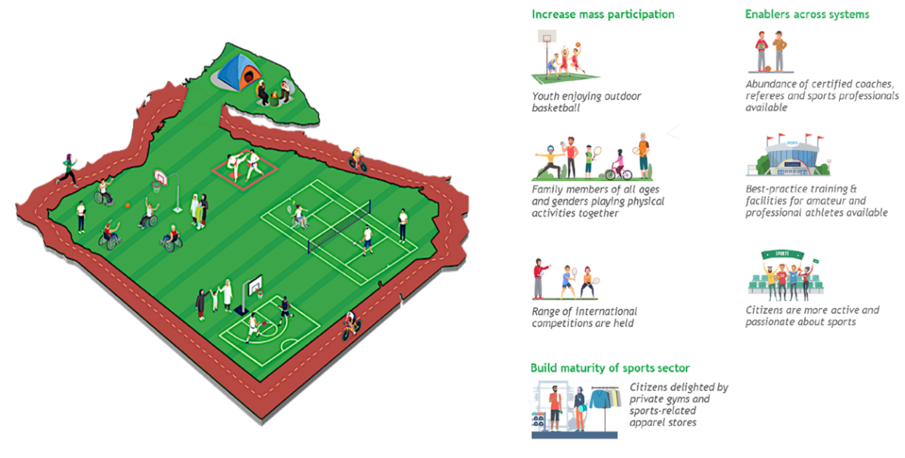
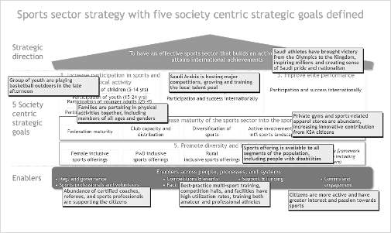
Our work - Creative Design Before
Graphic design
After
Project background:
Client has asked us to redesign this slide as this was the main slide in the deck which explains that the UAE government need to focus on improving their sports activities

Slide 24

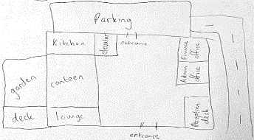
Our work -Creative Design Before
Graphic design
After – Isometric Illustration
Project background:
Client want was to come up with a rough layout for an office space that they were proposing to the client.
Instead of just drawing a layout in lines and icons, we had envisioned the same using isometric illustrations
Finance Office
Admin Office
Parking
Kitchen
Reception
Canteen
Entrance
Lounge
Garden
Deck

Slide 25



Our work - Image Editing
Graphic design
Project background:
Client had requested us to help them envision the new rack that they wanted to try for their supermarket which will enable then to organize more items on the rack

Slide 26
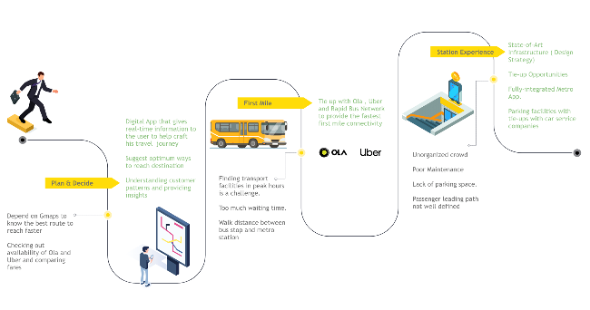
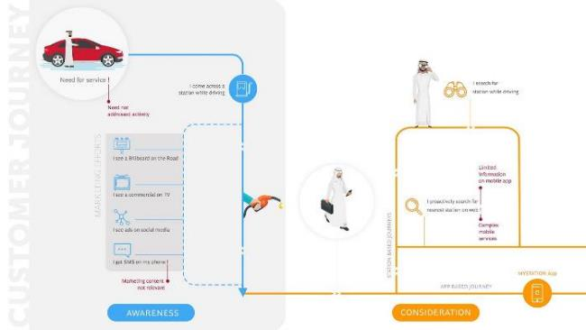
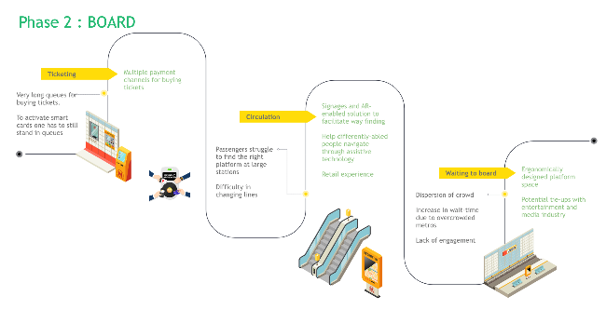
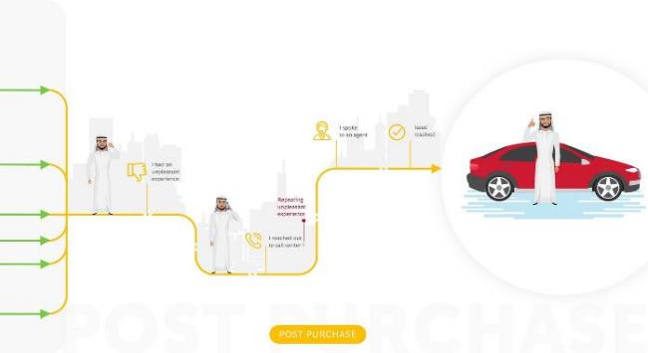
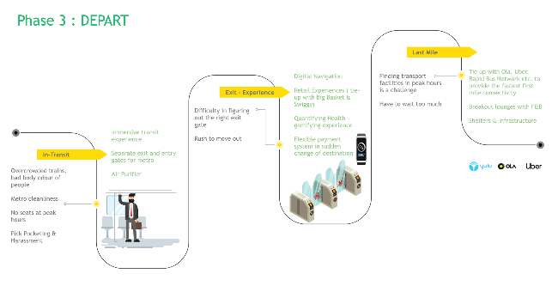
Our work - User journey maps
Graphic design

Slide 27
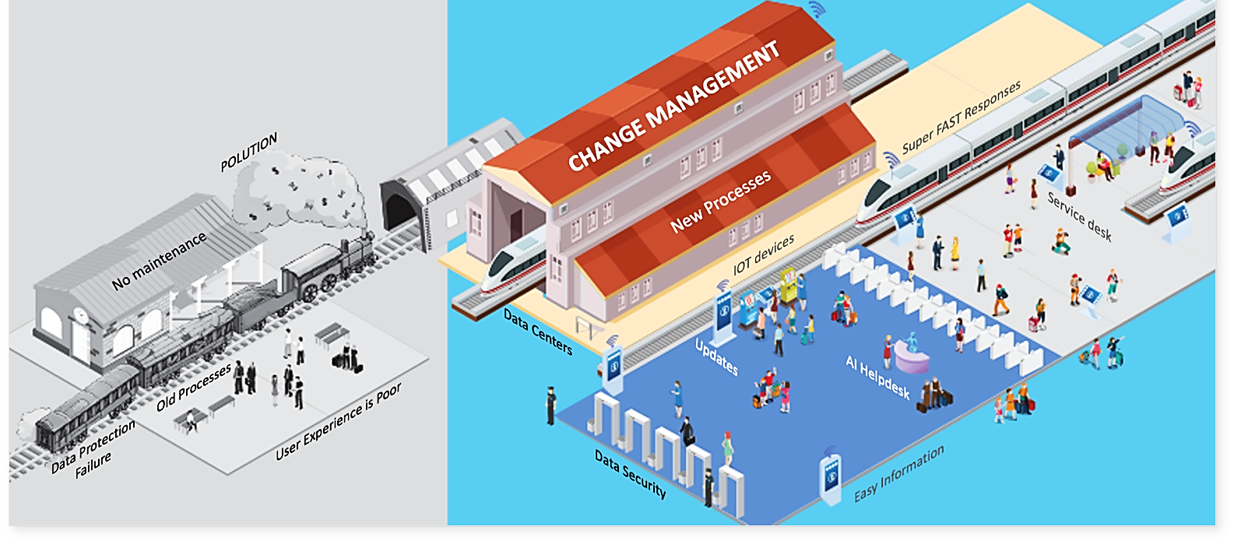
Our work - Concept Illustrations
Graphic design

Slide 28
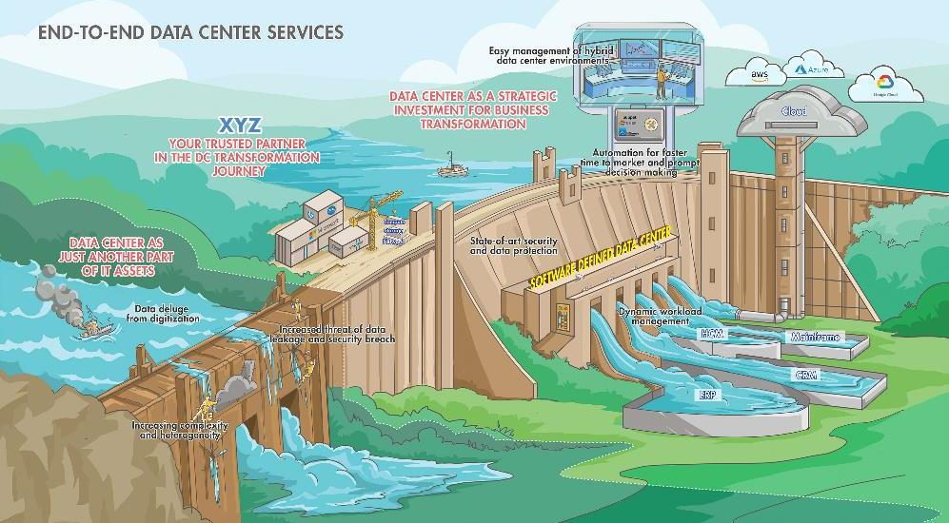
Our work - Concept Illustrations
Graphic design

Slide 29
Why work with us
Graphic design
Our team comes from the best global consultancies and work according to their standards
The team considers design as a problem solving challenge – Figuring out the client needs and delivering on them
Optimum confidentiality and integrity - ISO certified
World class Graphic design capabilities
We can take care of work from basic slide production, up to creative design
Full range of tools (ppt, pdf, video, image treatment etc)
Full compliance with confidentiality and ethics best practices
Adaptability
Leverage our scale, experience and expertise at your service – among the largest business services team in EMEA and thee Americas with 200 permanent staff
Different engagement models balancing price and flexibility
Offering flexibility and scalability
Multiple advantages of our nearshore locations (Casablanca, Cairo and mexico): Reasonable cost base, although offering high quality of service (staff with critical sense, same time zone etc.)
Benefits of pooling resources between several clients: synergies, cost syndication...
Providing value added services at a competitive price

Slide 30
Language services

Slide 31
Infomineo has a unique approach to Language services
Business
Translation
Traditional translation model
Infomineo model
Translators are either “poets” or “localizers”
They typically come from a literature/ language background
Their passion is to translate books
They are very experienced in literal translation, and can have trouble with contextualization in a business setting
The translation companies distribute the work to freelancers to reduce costs and maximize flexibility – They can’t guarantee the confidentiality of the information
The processes are often chaotic given the company managers are from a liberal arts and not a business background
Translators have a business AND translation background
They understand and like business and business contexts
They are trained and immersed in business-friendly environment
Fully able to translate the meaning of business language
Infomineo hires full-time translators working from the office – We are ISO 27001 certified
We are an outsourcing company managed by former consultants – We understand your agenda and put in place the processes which fit your needs
We work exclusively for consultancies, government entities and large corporations
We focus our translation on the region-specific languages: English, Arabic and French

Slide 32


Infomineo Language services Capabilities
Business
Translation
Language capabilities
Content types
Key expertise in Arabic/English in the directions AR-EN and EN-AR. French/Arabic and French/English can also be covered.
Translations into Modern Standard Arabic – localization of the translation is possible based on client requirements (i.e. adjust to Saudi, Egyptian or any other GCC context)
Very experienced in mirroring the client-specific language used in client documents thanks to close collaboration with clients. Highly accomplished in building and maintaining client-specific libraries.
Extensive experience with quality-focused, high-visibility documents for final clients (high-quality targets, short deadlines)
Extensive experience with efficiency-focused, internal documents for consulting companies or large corporates (lower quality targets, very short deadlines)
Multi-sector experience with extensive work done in the Public Sector, i.e. for consulting projects with GCC governmental clients
Experienced in handling different document types (e.g. end-of-project presentations, RfPs & proposals, legal documents, working files, internal and client communications)
Experienced in handling different document formats (PPT/ Excel/Word/PDF)

Slide 33
Our approach to helping you
Business
Translation
Intake
Execution
Delivery
Understanding client needs and objective
Structuring approach
Executing translation work
Handover
Get a deep understanding of the client request: language style, client vocabulary, dialect required, formatting needs
Understand the constraints – Deadline, time budget etc.
Assess the need to use OCR, automation, client translation memory
Perform flipping and formatting as required
Share expected delivery timing
Performing the translation, either fully “manually”, or through Computer Assisted Translation using industry-leading MemoQ
In-depth QA process
Updating the client regularly
Explaining the key translation choices made
Getting client feedback

Slide 34






Our work process
Business
Translation
Our business translators follow a simple work process for maximized effectiveness and control
The translation team is located in Egypt and is available from Sunday to Friday 11 hrs a day
1
2
3
4
5
Respond
Propose
Commence
Review
Complete
within 30 minutes to client’s email requests
a time budget and delivery deadline based on the volume of translation
the translation process and formatting, confirm deadline
translation output under senior proofreaders/ managers supervision
and send the final deliverable
One email address for all your design needs: translation@infomineo.com

Slide 35

Our work - Consulting Proposals
Business
Translation
Text Characteristics | Text is characterized by avoiding bulky text, using action titles Use of charts, process shapes, timelines and tables
Challenge | Linking ideas and capture the action titles without circumlocution Bound by the document design, formatting and style
Translation Methodology | Reading the document carefully, understanding its structure and flow of ideas Avoiding literal translation Employing best writing and translation techniques such as paraphrasing, loss and gain, functional shifts

Slide 36
Case Example:
Business
Translation
Source Text | Translation
Do not incur in multicurrency practices providing a preferential foreign exchange rate to non-oil industries through large subsidies | تجنب المزيد من التكاليف الناتجة عن اعتماد نظام تعدد سعر صرف العملة الذي يمنح الصناعات غير النفطية سعر صرف تفضيلي عبر تقديم الدعم المالي
Active industry policies are used frequently. Support industries but don't pick up winners Recommendation: subsidies to be conditional to performance, time bound with Sunset clause. Could however jeopardize good trade relations | سياسات دعم الصناعات النشطة هي من أكثر أدوات السياسات استخداماً، حيث تعمل على دعم الصناعات بشكل عام وليس دعم الصناعات الرابحة فقط التوصية: ربط الدعم المالي بالأداء ووفق أجل محدد (بموجب بند خاص يُحدد أجل انقضاء الدعم)، إلا أن ذلك قد يؤثر سلبياً على العلاقات التجارية الجيدة مع الدول الأخرى.
Industry is already highly consolidated with top 4 countries having a market share of 50+% for major crops | يخضع السوق لسيطرة عدد محدود من الجهات الفاعلة (تمتلك أكبر 4 دول حصة سوقية 50% من المحاصيل الرئيسية)
Countries with pegged currencies, who have interest in maintaining reserves to keep peg, as follows: Hard pegs to USD or currency basket Pseudo pegs to EUR | الدول التي ترتبط عملاتها بالعملات الأجنبية، والتي تسعى إلى الحفاظ على مستويات الاحتياطي النقدي الأجنبي لتثبيت سعر صرف عملتها كالآتي: * سعر الصرف الثابت مع الدولار أو سلة عملات أخرى * سعر الصرف الشبه ثابت مع اليورو
We helped a multinational consulting firm deliver an economic policy study to a ministry in Saudi Arabia, after the translated work was rejected by the ministry due to poor quality from other vendors

Slide 37

Our work - Client’s internal documents
Business
Translation
Text Characteristics | Text is not usually well written, but it is rich in details and concepts
Challenge | The challenge is to enhance the original text in terms of quality and strictly adhering to the legal structure and business concept
Translation Methodology | Performing Arabic to Arabic translation in a draft to restore the meanings that is distorted by the poor quality of the original text Avoid text entanglements by performing semantic translation and leveraging conjunctions and punctuation marks Make sure that your legal/official drafting is coherent but avoid overcomplicating it with legal jargons

Slide 38
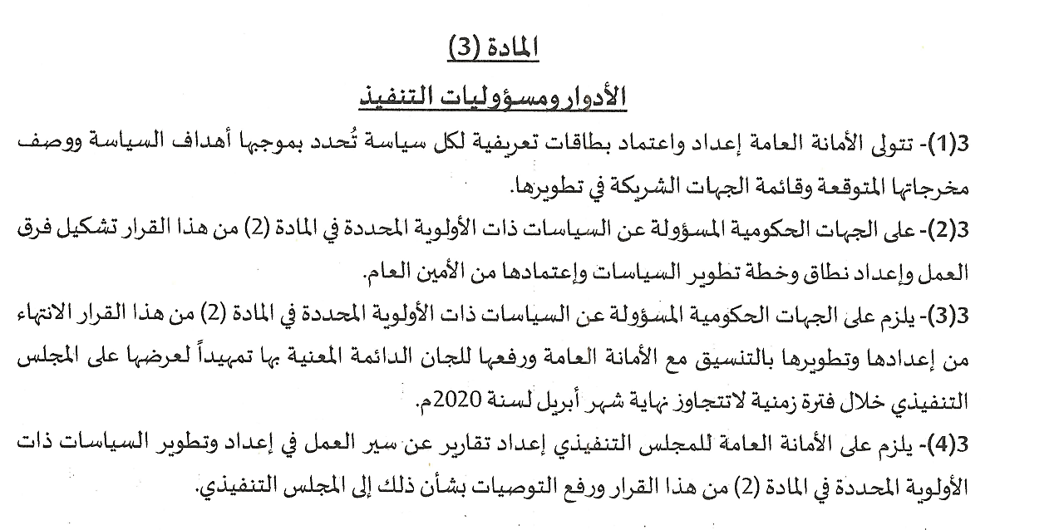
Case Example
Clients require documents with highest quality and fastest turnaround; therefore, we deliver these docs by focusing on meaning and structure
Business
Translation
Source Text | Translation
Article (3) Roles and Implementation Responsibilities 3(1) The General Secretariat shall develop and approve profiles for each policy, specifying its objectives, expected outputs, and entities engaged in its development. 3(2) Government entities responsible for the priority policies, specified in Article 2 of this resolution, shall form task forces, prepare the scope and development plan for such policies, and submit to the Secretary-General for approval. 3(3) The Government entities, responsible for the priority policies, specified in Article 2 of this resolution, shall prepare and develop such policies in coordination with the General Secretariat and submit it to the concerned standing committees prior to their submission to the Executive Council before end of April 2020. 3(4) The General Secretariat of The Executive Council shall report the progress made on the development of priority policies specified in Article 22 of this resolution and provide recommendations thereon to the Executive Council.

Slide 39

Our work - Requests/Projects Support
Business
Translation
Text Characteristics | Miscellaneous snippets from different sources that depend on the topic of the request/project
Challenge | A simple text that is easy to digest and merged with additional content without affecting consistency
Translation Methodology | Try to understand from the analyst the scope of his/her assignment and have more context Avoid jargons and provide a plain text with more emphasis on business concepts

Slide 40
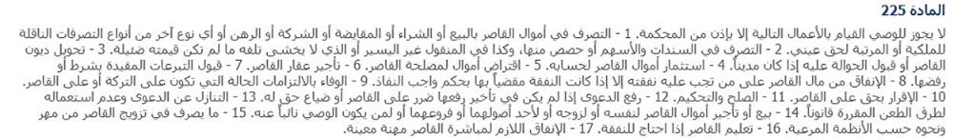
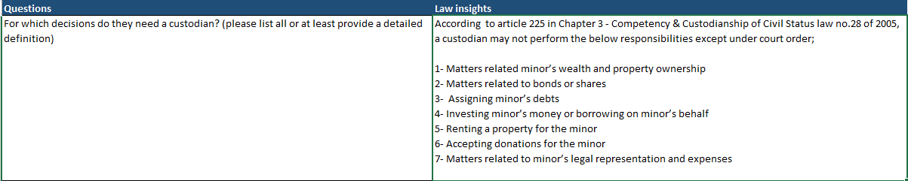
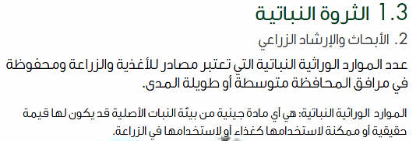
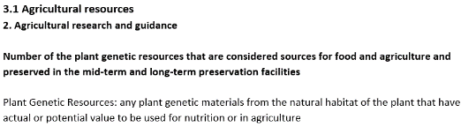
Case Example
We support knowledge specialists and analysts, either internally or at consulting firms, with translations of data and insights to be plugged in their deliverables
Business
Translation

Slide 41

Our work - Questionnaire/Discussion Guide
Business
Translation
Text Characteristics | Text is divided into sections starting from introduction and warming-up and moving progressively to core questions of the client study Significant differences between the language structure of questionnaires and discussion guides - discussion guides are designed to be more interactive and the questions are inclined more towards probing, questionnaires on the contrary are more direct and have MCQs
Challenge | Understanding the purpose of the study and not leaving loopholes in the questions that might deviate the respondents’ answers For questionnaires, being aware of the type of communication with respondents whether it is Personal interviews using notes on paper (PAPI), on a computer (CAPI), through telephone (CATI) or through a web link (CAWI)
Translation Methodology | Restoring the interactive style of the text by employing best writing techniques and creativity in choosing words Making sure to render the correct names of brands and products Avoiding ambiguity in instructions translation and making it simpler. even if words have to be omitted from the source

Slide 42
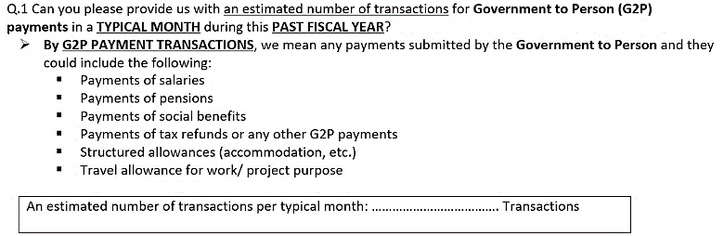
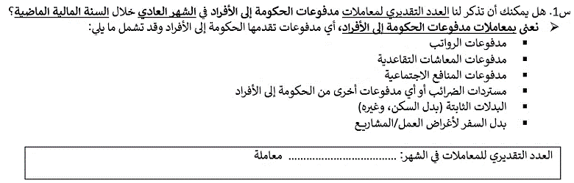
Case Example:
We translate the most complex and wide-scale discussion guides and questionnaires for private and public sector clients, and on critical topics such as financial transactions
Business
Translation

Slide 43
Why work with us
Business
Translation
Our team of Business Translators fully understands business context and business language across sectors
Working for the most demanding global consultancies
Access to leading CAT tools
Optimum confidentiality and integrity - ISO certified
World class translation capabilities
We can take care of work across document types and difficulties
We are flexible to adapt to either deliver highest quality, fastest turn-around or hybrid focus
Adaptability
Leverage our scale, experience and expertise at your service – among the largest brainshoring team in EMEA with 200 permanent staff
Different engagement models balancing price and flexibility
Offering flexibility and scalability
Multiple advantages of our near shore location (Cairo): Reasonable cost base, although offering high quality of service (staff with critical sense, same time zone etc.)
Benefits of pooling resources between several clients: vendor databases costs, etc.
Providing value added services at a competitive price

Slide 44
Data Analytics

Slide 45
Infomineo has a unique approach to Data Analytics
Analytics
Traditional model
Infomineo model
Most Data analytics companies provide standard models that they transpose from a client to another. Such models very often remain at Proof-Of-Concept stage, ads integration with IT systems is not complete
Most Data analytics providers are specialized in Visualization tools, e.g. Tableau, Power Bi etc.
Most providers work on a project basis – After project completion the models can be hard for clients to maintain over time.
Some providers retain rights on the Intellectual property they generate
We are problem solvers, we need to understand your question or challenge and will find the data & models that answers your questions. The output is co-constructed with our client and not a model taken off the shelf.
We have a multi capabilities team that can provide you an end-to-end approach from cleaning the data to visualizing the model output.
We work on a retainer basis, we are an extension of your team, and make it easy to work with us, which 1/minimizes the time you spend on paperwork and 2/allows you to work with us on an iterative basis.
The output of our work will become a knowledge asset of our client who will hold the intellectual property of it.

Slide 46
Infomineo offers a full suite of Data Analytics Services
Analytics
Three Levels of Analytics
Business Oriented Approach
Three Types of Support
Data Exploration & Cleaning
Data Visualization : reports, automated dashboards
Gathering Data from various storage, Assessing Data Quality and processing cleaning and wrangling
Data Analysis
Infomineo’s teams demonstrate a high Business sense
We work in an iterative approach to fulfill clients needs quickly
Data Preparation
Statistical Analysis
Model building & tuning
Model evaluation & retraining
Business & Data Understanding
Agile Methodology
Data
Science
Interactive Visualization
Building and maintaining self service analytics
Delivery Management
Feature Engineering : Data wrangling, Data transformation
Model Deployment & scalability
Building predictive and prescriptive models & possibility to deploy to production
Data Engineering
Release & Change Management are handled: versioning, unit tests, model validation, code reviews, documentation…
Modeling

Slide 47
Our approach to helping you
Analytics
Intake
Execution
Delivery
Understanding client needs and objective
Get a deep understanding of the client objectives:
Type of analytics support considered
Business questions to answer
Assess available data, data needs if any, critical data elements to take care of
Planned use of the analytics outputs
Structuring approach
Define the best data analytics strategy to answer the client’s business objective
Estimate the time needed
Define the type of output needed
Executing Analytics
Leveraging a full range of analytics capabilities
Data Preparation
Identifying Data Sources
Extracting & Transferring Data
Metadata & Dictionaries
Merging of various data sources & adding new data
Assessing Data Quality
Handling Outliers
Restructuring Data for analysis
Making features extractions
Business & Data Under
standing
Agile Metho
dology
Data Modeling
Build algorithms to answer the business question (binary classification, segmentation, forecasting …)
Evaluation and validation of the algorithm
Deriving insights
Performing in-depth quality assurance
Analyzing the data outputs to derive insights in line with the initial client ask
Handover
Presenting the approach, results and potential limitations
Sharing all the documentation & codes
Getting client feedback
Definining scaling with clients’ IT Teams (to be scheduled if any)
Performing regular model maintenance (to be scheduled if any)
Delivery Management
Exploratory Analysis
Descriptive analysis
Data visualization
KPIs
Data story telling

Slide 48
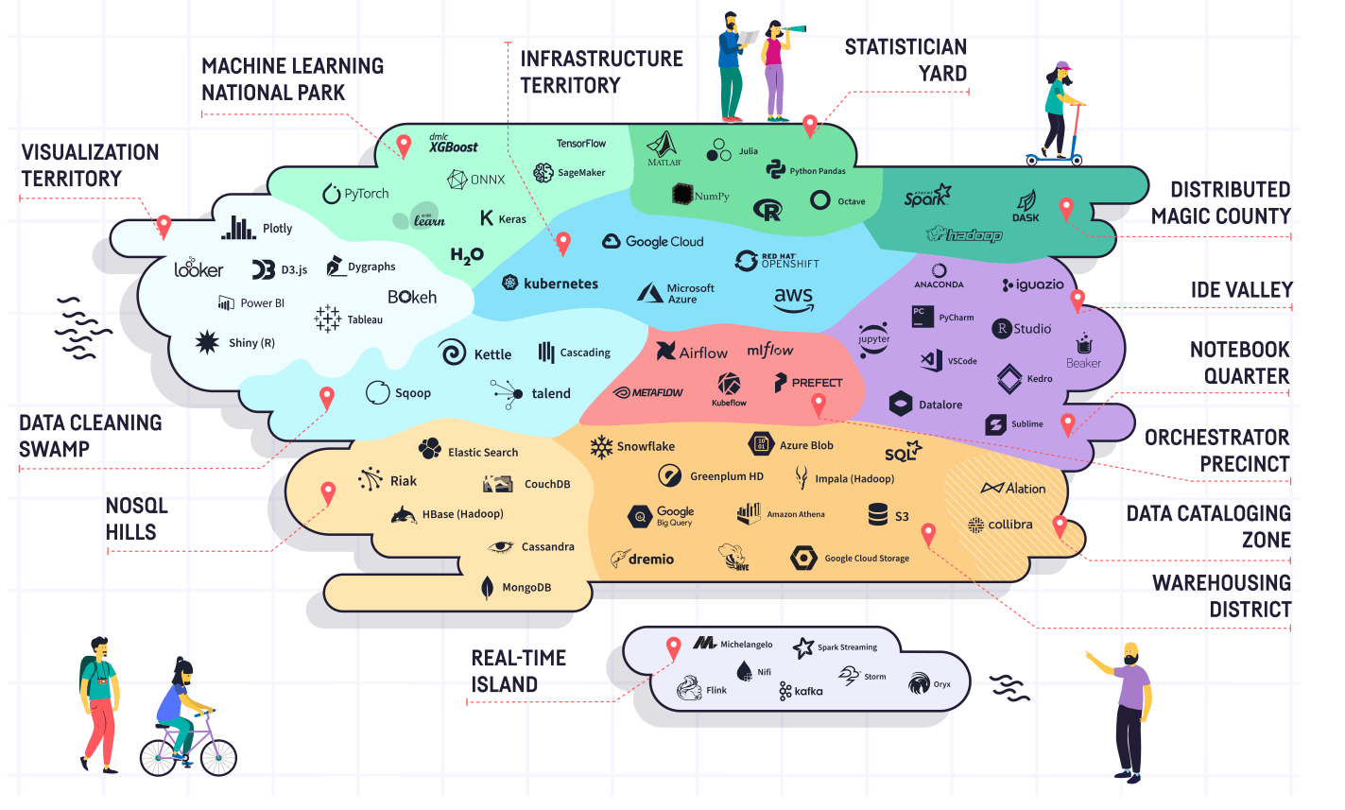

Technologies Infomineo can be handling
Capabilities we already have
Capabilities we are building

Slide 49


CASE STUDY
Client Challenge
Our Solution
Outcome
Client:
The client wants to have an automatized Human Resource Dashboard to track, analyze and report on HR KPIs.
The firm was looking for:
The company decided to use Infomineo’s Data Analytics service as a solution to cover:
The firm recognized that the quality of the Data Analytics service provided a useful reporting tool resulting in:
A multinational firm
Data Quality & Consistency problems between the various Data sources
Dashboard creation that reflects HR Team needs
During the project, Data were corrected in the ERPs :
Manual files where not used anymore
Data Quality improved by 55% for critical data elements
Effective and quick solution
“I was really impressed by the responsiveness of the team : they came up with a first and quite impressive dashboard proposition within only a couple of days. I also really appreciated the quality of the work; it was really helpful for us to identify the data cleansing needed in our ERP.”
─ Chief Human Capital Officer (Client)
Estimated 1 FTE from the HR department could be reallocated to other tasks
Helped the company to start its Data Transformation
Infomineo has been asked to work with client’s Finance Team to create another dashboard
Smooth integration with its existing ERPs
Lower cost than buying from a specialized company an HR Dashboard tool
Ad-hoc deliverables :
Dictionaries, Creation of Metadata, Data Quality On boarding

Slide 50
Why work with us
Research
Combination of Data Analytics and Data Research methodologies
Opportunity to work with a unique professional network
Optimum confidentiality and integrity - ISO certified & RGPD Compliance
World class Data Analytics capabilities
We can work on specific tasks or lead full end to end projects
We can support in the long run to maintain and adjust solutions
Full compliance with confidentiality and ethics best practices
Adaptability
Leverage our scale, experience and expertise at your service across our geographies
Different engagement models balancing price and flexibility
Offering flexibility and scalability
Multiple advantages of our nearshore locations (Casablanca , Mexico & Cairo): Reasonable cost base, although offering high quality of service (staff with critical sense, same time zone etc.)
Benefits of pooling resources between several clients: tools costs, etc.
Providing value added services at a competitive price

Slide 51
Working with Infomineo

Slide 52
Infomineo offers three relationship models
Retainer
Service package
Project
90% of Infomineo’s business today
Mostly used as a complement to a retainer
Used by clients who can only procure based on a fixed scope
The client subscribes to a monthly capacity (by batches of 150 hours) and uses it as per their needs
The client sees Infomineo as their team or an extension of their team
Strong integration with
Daily communication
Dedicated team members
Dedicated communication channels
Mutual training
Works starts within hours
The client subscribes to a package of “service points” and uses it across Infomineo services
The client complements their own capabilities or their Infomineo retainer
Medium level of integration
Weekly/monthly reporting
Dedicated account manager but “flying” team members
Dedicated communication channel
Work starts within days
The client shares a scope, Infomineo prepares a proposal and executes on the agreed scope
The client hires Infomineo as a “one off” support on a specific scope
Limited integration
Kick off call and weekly updates
Teams staffed ad hoc
Works starts as soon as the project team becomes available

Slide 53





How does a retainer work
Infomineo retained team acts as an extension to your team, offering maximum transparency, efficiency, flexibility and knowledge sharing while minimizing the “transaction cost” (no need to negotiate a contract for every request).
Concretely, Infomineo puts in place a dedicated team for each client composed of
A Manager who is the client main point of contact - He/she handles the requests, coordinates the staffing, coaches the team members, performs QA and prepares a monthly reporting
One or several analysts, translators and/or designers who deliver the hours of service you have subscribed to (by batch of 150 hours)
These team members have access to all the resources and capabilities of Infomineo (tools, databases, experts etc.)
Most of the time the clients work with the same staff, but they could be rotated as needed (e.g. for specific expertise, language skills)
Beyond the retained capacity the client can subscribe to a service package giving them access to all our other services (see next slide)
The retainers uses a one-year contract with ramp-up, ramp- down and exit clauses.
The service is billed at the end of each month

Slide 54
How does a service package work
Client subscribes to a fixed amount service package which gives access to service points. Each Infomineo service (research, translation, design, expert network) costs a certain number of points (per hour, per word translated or per interview). Points are deducted from the package as per usage.
Concretely, Infomineo staffs a dedicated manager for each client as single point of contact
The manager
Receives the requests and validates the point expense with the client
Directs the requests to the right team at Infomineo
Coordinates communication, performs QA and sends the deliverable
Updates the client on a weekly/monthly basis reg. the points used and the remaining balance
Capacity offered within a predefined timeline with SLA varying with the package size
Once the client uses one of Infomineo service on a regular basis the manager might propose to start a retainer to save costs and increase the SLA
The points expire after a certain duration (depending on package size)
The package is billed upfront

Slide 55
How does a project work
Client defines a fixed scope of work. Infomineo prepares a proposal outlining the approach and expected deliverables together with a fixed price. Once contract is signed the team delivers the project.
Concretely, Infomineo staffs a team to execute on the project
The projects
Starts with a kickoff call where the expectations are defined
Then the team executes as per the initial workplan - If the client wants to increase the scope the budget needs to be revised
Regular update calls are planned as per the project timeline.
A final handover call closes the project
Project start depends on the availability of staff.
If the client has recurring projects a retainer will be proposed
The project is billed 50% upfront and 50% at completion

Slide 56






What benefits are there in engaging Infomineo on a retainer basis?
Quality of services
Effectiveness & productivity
Flexibility & scaling
Time & Money
Access to the largest team of research/ design/ translation specialists in EMEA
Customized deliverables tailored to your specific needs
Proficient use of the best tools and sources for each service
Effective execution of time-consuming tasks as Infomineo focuses on its core services 100% of the time
Continuous improvement by developing customized trainings and career trajectories to allow the best support possible to our clients
Flexibility in adjusting the scope and prioritizing tasks
Infomineo is a turnkey and scalable solution – execution phase starts within days of an agreement and can scale up very quickly
Smooth and systematic handover process for replacement and scalability purposes
Utilizing the service hours to yield the maximum output (projects, database, newsletters, ad-hoc requests)
Retainer rates are less than the ad-hoc and project rates
Payment takes place on a monthly basis
Consistency of delivering high quality outcome
Better decision-making based on high-quality insights, design or translation
Fast turnaround of deliverables
Increasing your internal team’s efficiency by allowing them to focus on value-added tasks
Less admin work (contracting, approvals, etc.)
Ease of scaling according to business needs (saves recruiting time)
Ensuring business continuity
The price of Infomineo’s service is on average 30% cheaper than the cost to develop an equivalent service internally – taking into account all costs involved

Slide 57



Why is Infomineo the best partner for you?
Capabilities & quality
Information security
Skills transfer
Return on investment
In our 11 years in business we have established the reputation of the highest quality provider of research, translation and design services in the EMEA region
We are happy to put you in touch with our clients so you can get their testimonies
The data we handle is highly confidential, we have made significant investments in information security and are certified ISO 27001
We insist on both-ways skills transfer.
Our staff need to spend time with you to understand what you do, how you work and what your challenges are.
We would be happy to welcome some of your team members in our offices for training or secondment
We are conscious that you will evaluate your return on investment by assessing how much work we deliver vs the price you pay. We will focus on
Utilisation – Reporting on our utilization rates, proactively reaching out when we have capacity available, organising our work between ad hoc and recurring tasks
Efficiency – You will have full transparency on how we spend our time and will be able to challenge us

Slide 58
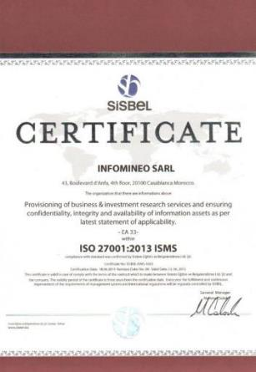

Confidentiality and Security
As an ISO 27001 certified company, Infomineo is compliant with the highest IT security norms.
Our ISMS comprises
Procedures and policies: For example all employees and providers sign confidentiality agreements, we have in place an overarching security policy, password policy, an internet policy and an acceptable use policy
Plans: We are regularly conducting risk assessments and have put in place a BCP, a risk treatment plan as well as contingency and disaster recovery plans etc.
Audit measures: Each element in the treatment plan has an audit process in place
The key elements of our ISMS are
Full cloud: All our data are stored on Google Drive, which is complemented with advanced administration and backup tools and a triple internet connection– Meaning limited data loss risks and no internal network, hence limited hacking/virus dissemination risks, and a high level of service
Compliant hardware and software: Disabled DVD drives and USB ports, users without admin rights
Physical security: Offices with IR cameras, 24/7 surveillance, computers attached to desks
Employee commitment: All employees are informed and trained on the ISMS.

